Slide 1
Introduction
Laying infrastructure
Use cases of OpenSTAAD
What we explore
OpenSTAAD

Slide 2
Introduction
OpenSTAAD
Laying infrastructure
Use cases of OpenSTAAD
What we explore

Slide 3
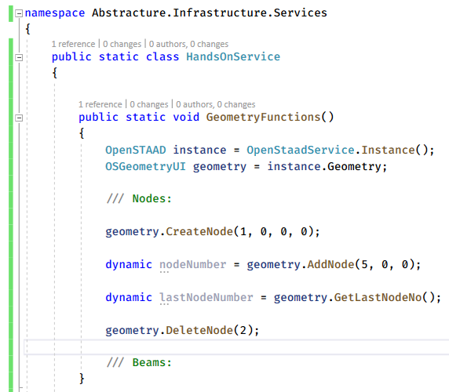
OpenSTAAD

Slide 4
OpenSTAAD

Slide 5
OpenSTAAD

Slide 6


Slide 7
Introduction
OpenSTAAD
Laying infrastructure
Use cases of OpenSTAAD
What we explore

Slide 8
Introduction
OpenSTAAD
Laying infrastructure
Use cases of OpenSTAAD
What we explore

Slide 9
Introduction
OpenSTAAD
Laying infrastructure
Use cases of OpenSTAAD
What we explore

Slide 10
Introduction
OpenSTAAD
Laying infrastructure
Use cases of OpenSTAAD
What we explore

Slide 11
OpenSTAAD
Introduction
Laying infrastructure
Use cases of OpenSTAAD
What we explore

